Slide 1
DataSource
Walter Reade, Ashley Chow. (2023). Binary Prediction of Smoker Status using Bio-Signals. Kaggle. https://kaggle.com/competitions/playground-series-s3e24

Slide 2
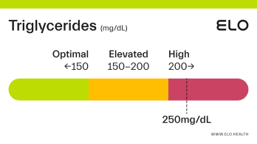
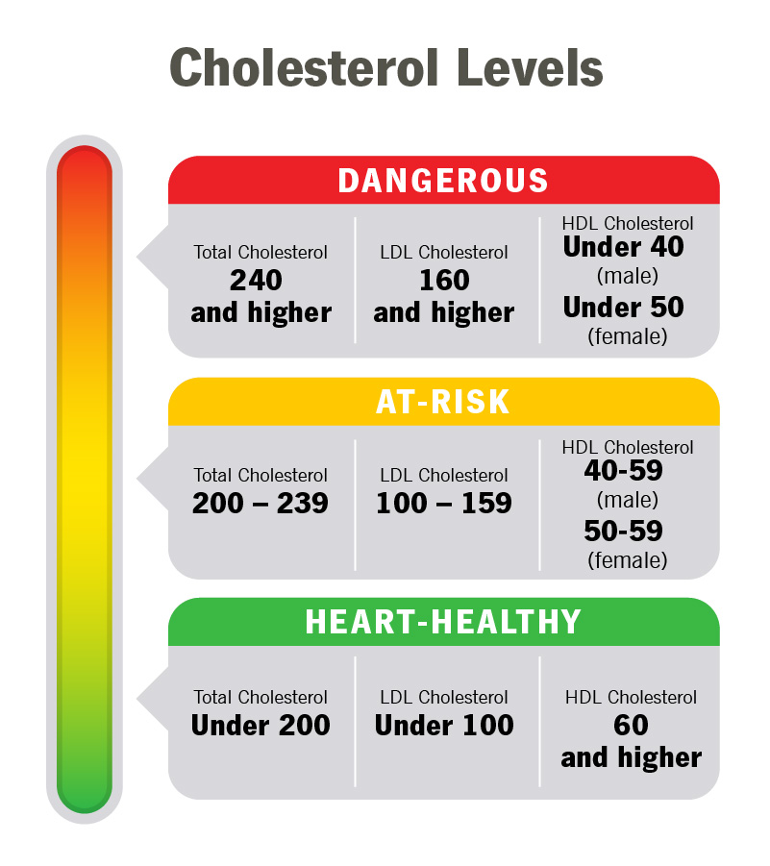

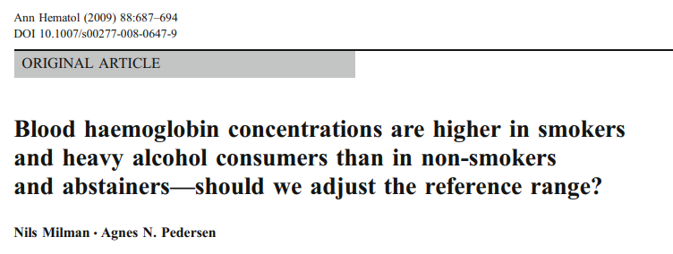
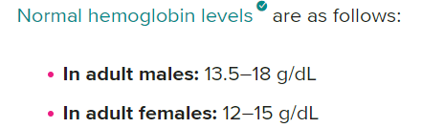
Cholesterol Levels are Averaged Out for Males and Females
Total Cholesterol –
240+ - Dangerous
200-239 -> At Risk
< 200 -> Healthy
LDL
160+ - Dangerous
100 – 159 -> At Risk
< 100 -> Healthy
HDL
< 45 - Dangerous
45 – 60 > At Risk
60+ -> Healthy
Triglycerides Levels
200+ - Dangerous
150-200 -> At Risk
< 150 -> Healthy
Source: https://my.clevelandclinic.org/health/articles/11920-cholesterol-numbers-what-do-they-mean
Source: https://hal.science/hal-00535009/document

Slide 3
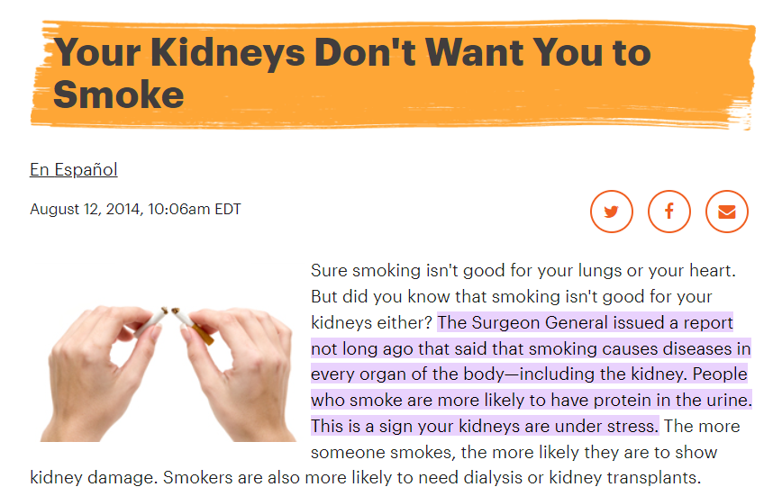
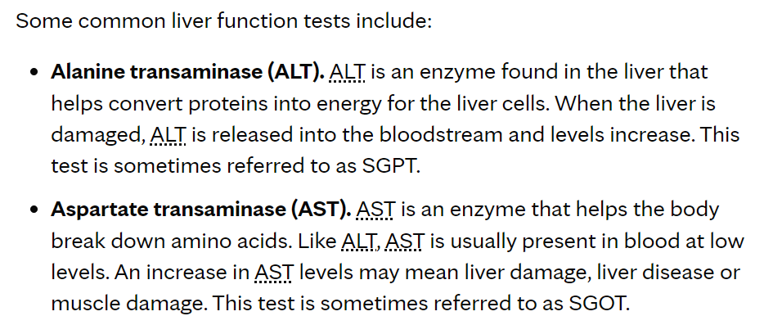
Source: https://www.mayoclinic.org/tests-procedures/liver-function-tests/about/pac-20394595#:~:text=Standard%20range%20blood%20test%20results,8%20to%2048%20U%2FL%20
Source: https://www.kidney.org/news/kidneyCare/winter09/DontSmoke#:~:text=The%20Surgeon%20General%20issued%20a,your%20kidneys%20are%20under%20stress

Slide 4
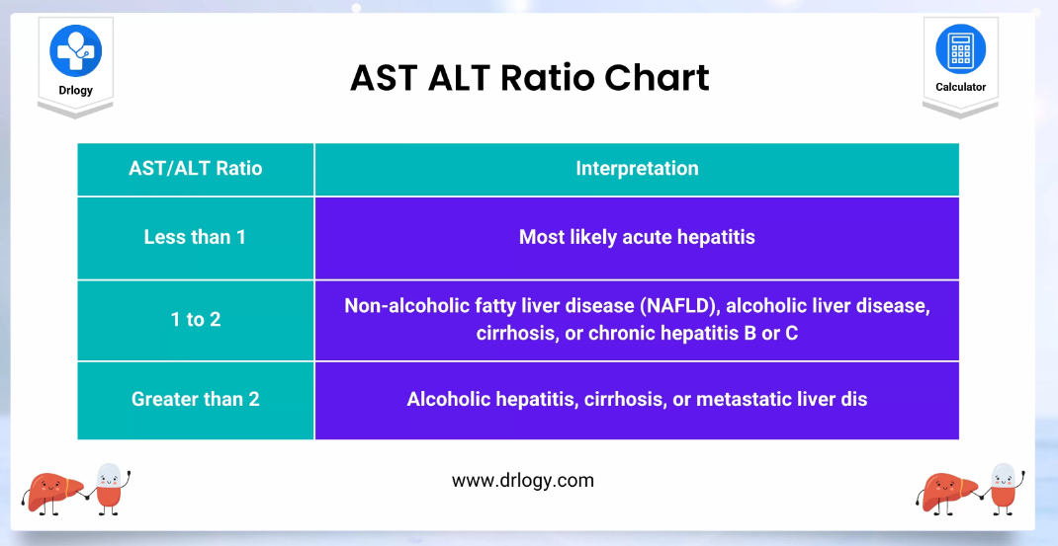
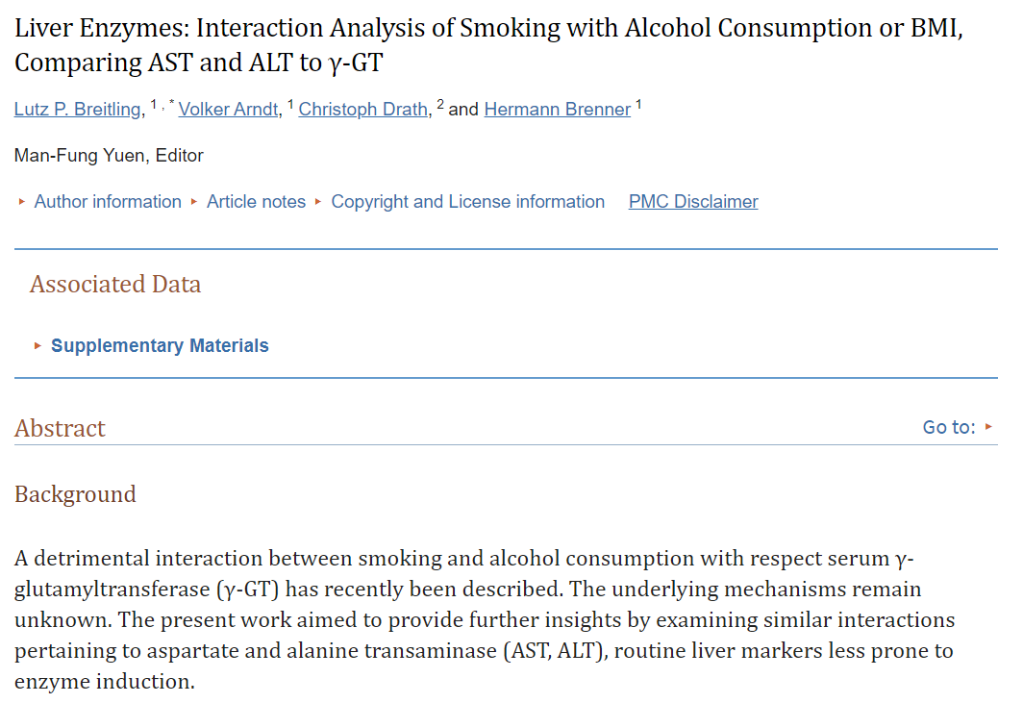
Source: https://drlogy.com/calculator/ast-alt-ratio
Source: https://www.ncbi.nlm.nih.gov/pmc/articles/PMC3222662/

Slide 5
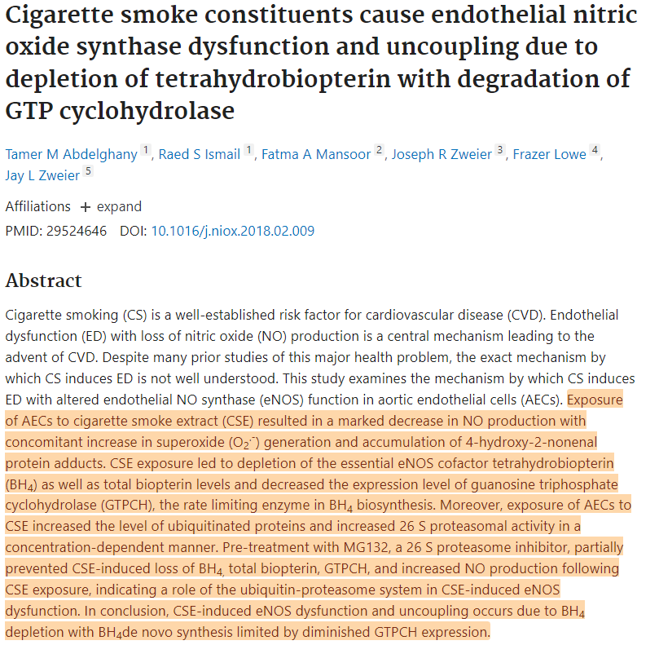
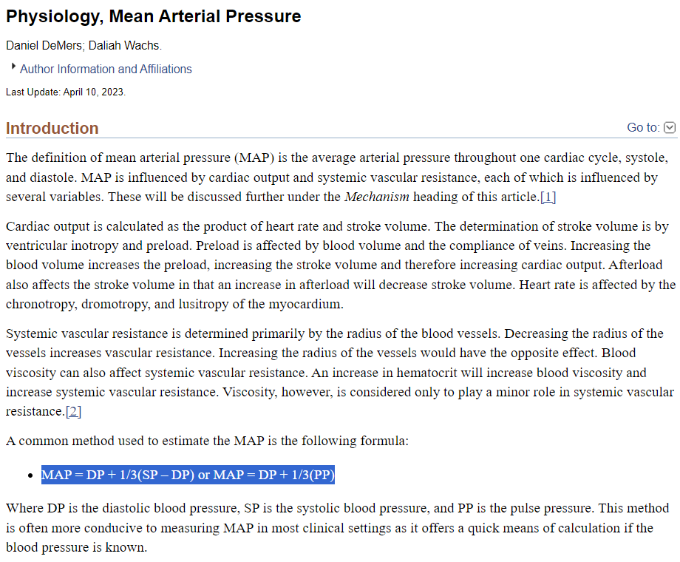
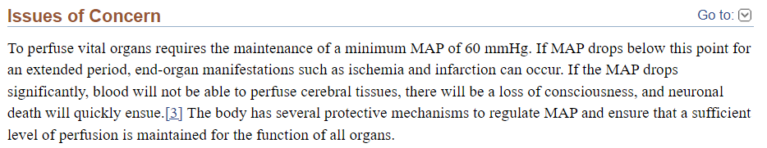
Source: https://pubmed.ncbi.nlm.nih.gov/29524646/
Source: https://www.ncbi.nlm.nih.gov/books/NBK538226/

Slide 7
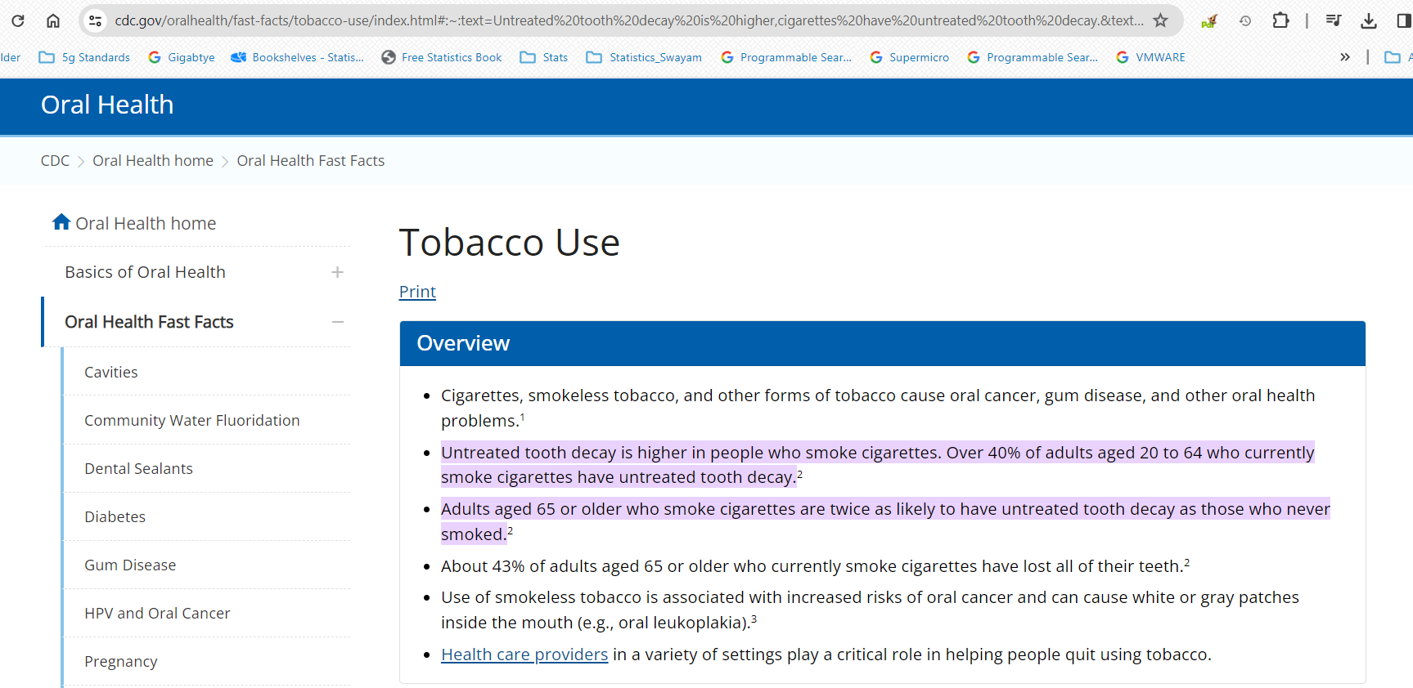

Slide 8
